Slide 1
Packages and Interfaces
Ghulam Mujtaba Shaikh

Slide 2
Agenda
Recap of the last lecture
Packages
Interfaces
Recap

Slide 3
Introduction to Packages
A package is a collection of different classes.
It is a way to group to group variety of class and interfaces.
The grouping is done usually based on functionality.
The classes used in a package can be used in any program that imports that packages and class.
It provides the compartmentalization.
It helps separate the design and coding.

Slide 4
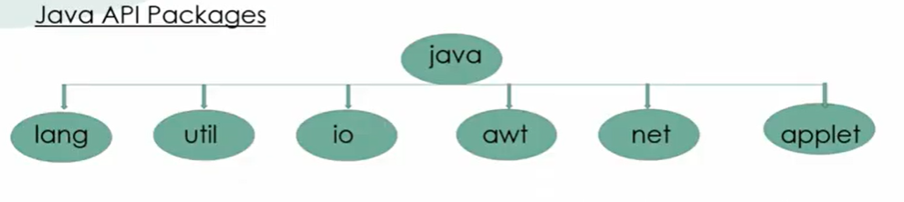
Introduction to Packages
There are two types of packages in java
  API Packages (a.k.a. System or Predefine or builtin Packages)
  User-defined packages
Java API (Application Programming Interface) packages

Slide 5
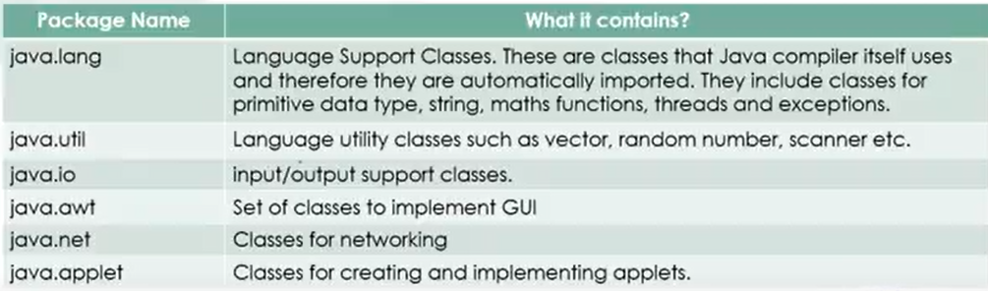
Introduction to Packages

Slide 6
Introduction to Packages
There are two ways to access the classes stored in a package.
First, to use the Fully Qualified Name (FQN)
Example: import java.util.Scanner
Example: import java.awt.Color
Second, to use the package name with the method name while coding.
Example: double y = java.lang.Math.sqrt (9) ;
Here java.lang is a package, Math is a class and sqrt is the method of Math class.

Slide 7
Creating the User-defined Packages
For creating the user-defined packages, we need to first the structure of the package.
First decide the name of the package and then create a sub directory with the same name inside the bin directory of java.
Now, here you must create a program in which you have to type the code.
See the example on next slides.

Slide 8
Way No. 1

Slide 9
Coding Steps
Create a new notepad file and write the following code.
Save the file in .\JDK\BIN\Books\Book.java
Compile: c:/JDK/BIN> Javac PackageName\FileName.java
c:/JDK/BIN> Javac Books\Book.java

Slide 10
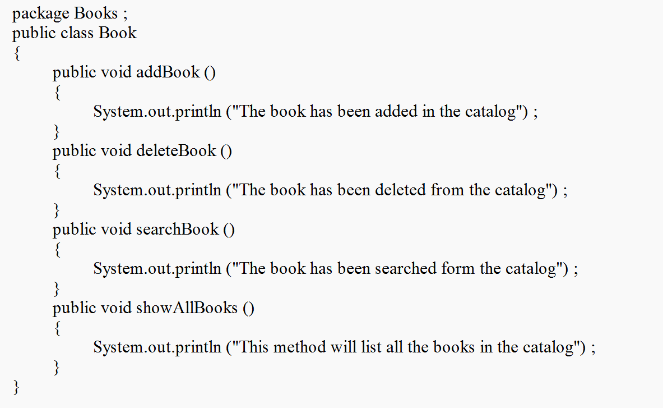
Coding Steps

Slide 11
Coding Steps
Create a new notepad file and write the following code.
Save the file in .\JDK\BIN\TestBook.java
Compile: c:/JDK/BIN> Javac FileName.java
c:/JDK/BIN> Javac TestBook.java
Run the file using command : c:/JDK/BIN> Java TestBook

Slide 12
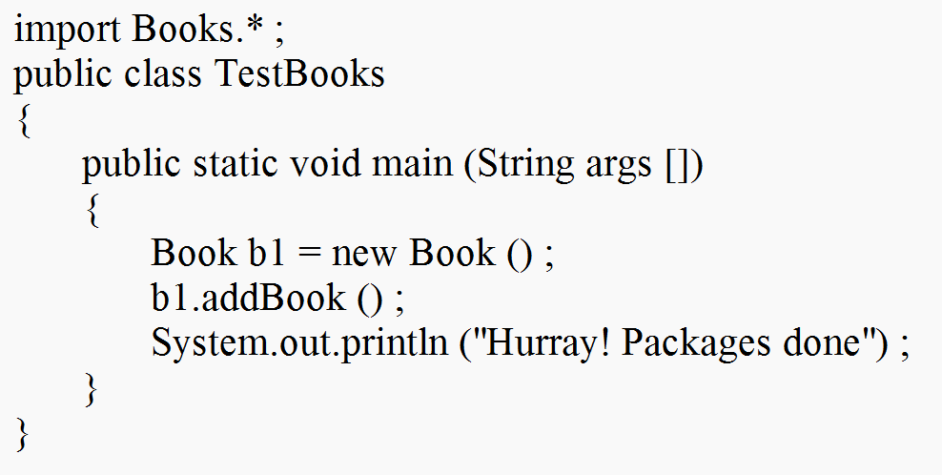
Coding Steps

Slide 13
Way No. 2

Slide 14
Coding Steps
Create a new notepad file and write the following code.
Save the file in .\JDK\BIN\Book.java
Compile: c:/JDK/BIN> Javac -d . FileName.java
c:/JDK/BIN> Javac –d . Book.java
This will automatically create the folder.
Put class files in that folder
That class files can be run on any platform

Slide 15
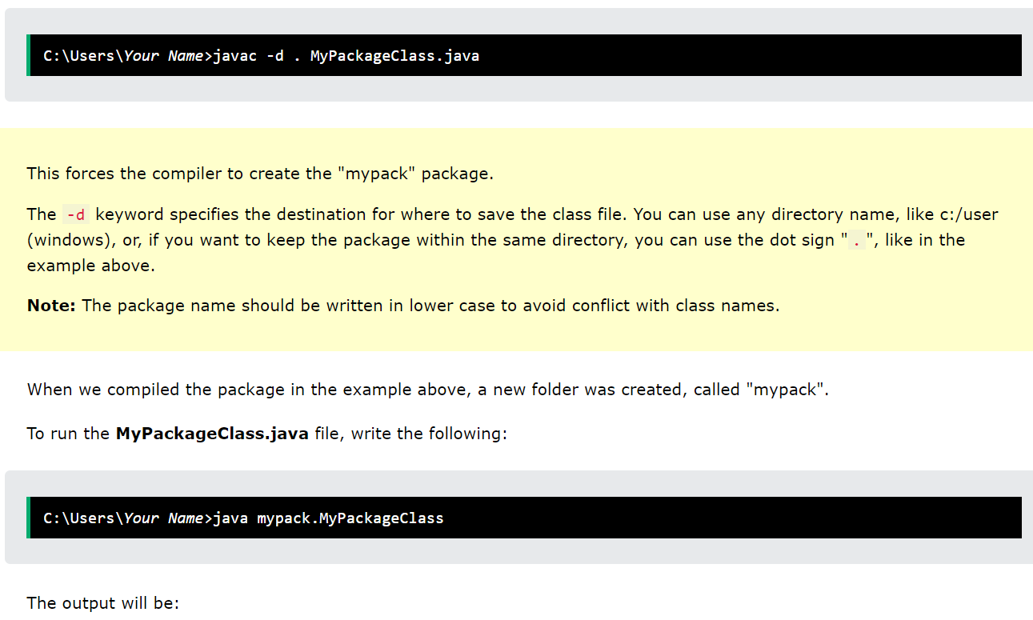
Coding Steps

Slide 16
Coding Steps
Create a new notepad file and write the following code.
Save the file in .\JDK\BIN\TestBook.java
Compile: c:/JDK/BIN> Javac FileName.java
c:/JDK/BIN> Javac TestBook.java
Run the file using command : c:/JDK/BIN> Java TestBook

Slide 17
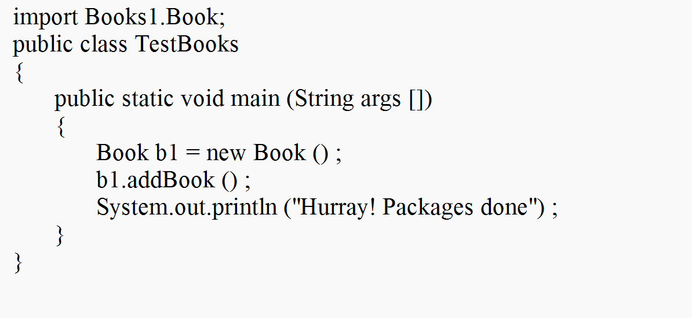
Coding Steps

Slide 18
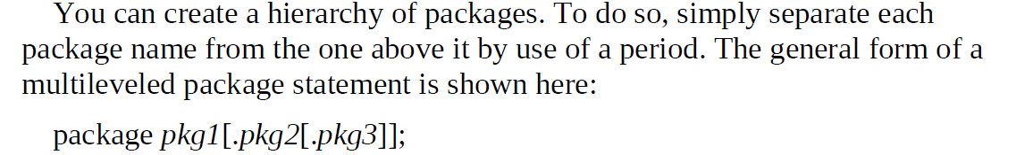
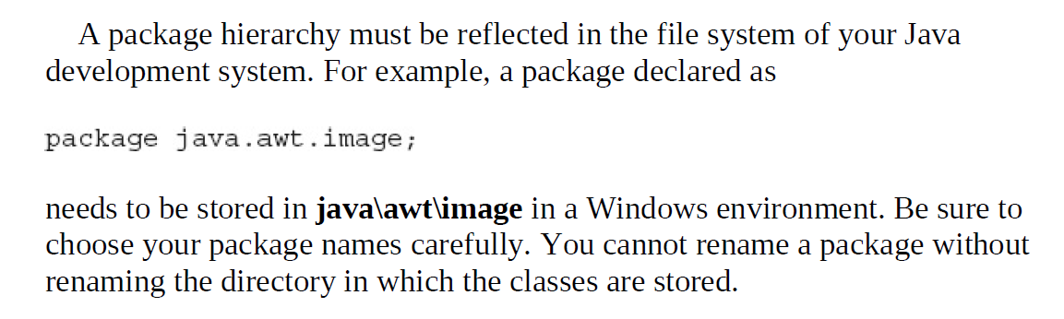
More About Packages

Slide 19
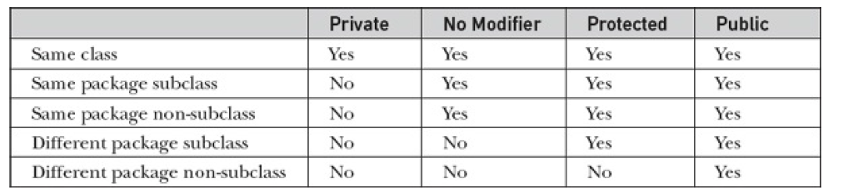
Access Protection

Slide 20
An Access Example
Let's assume we have two packages - "com.example.package1" and "com.example.package2". Inside "com.example.package1", we have a class called "Class1", and inside "com.example.package2", we have a class called "Class2". We will use access modifiers to control the access of these classes and their members.

Slide 21
An Access Example: public specifier
Public access modifier: Public members can be accessed from anywhere, both inside and outside their package. Here's an example:

Slide 22
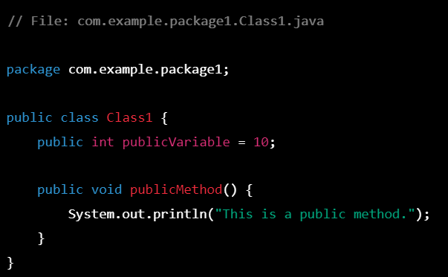
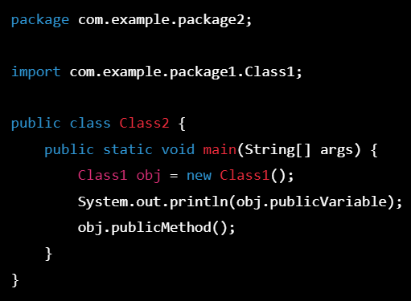
An Access Example: public specifier

Slide 23
An Access Example: public specifier
In the above example, we have a public variable and a public method inside "Class1". We can access them from "Class2" without any issues, even though they belong to a different package.

Slide 24
An Access Example: default specifier
Default access modifier: Members with default access can only be accessed from within their own package. Here's an example:

Slide 25
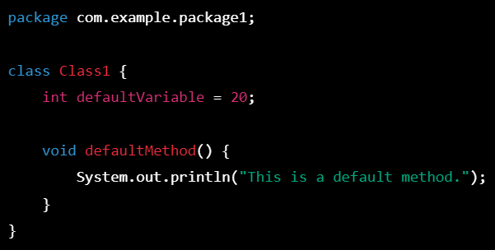
An Access Example: default specifier

Slide 26
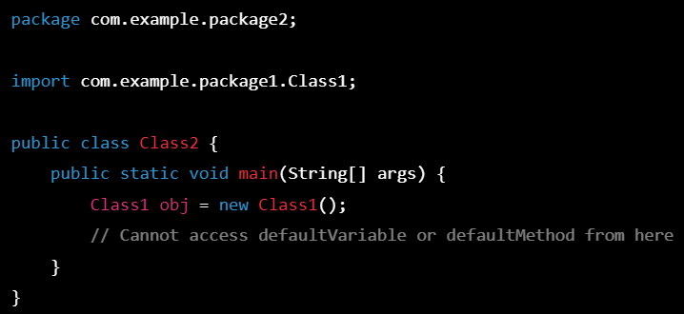
An Access Example: default specifier

Slide 27
An Access Example: default specifier
In the above example, we have a default variable and a default method inside "Class1". We cannot access them from "Class2" as it belongs to a different package.

Slide 28
An Access Example: private specifier
Private access modifier: Private members can only be accessed from within their own class. Here's an example:

Slide 29
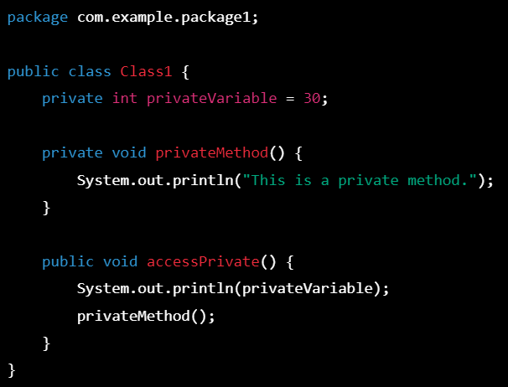
An Access Example: private specifier

Slide 30
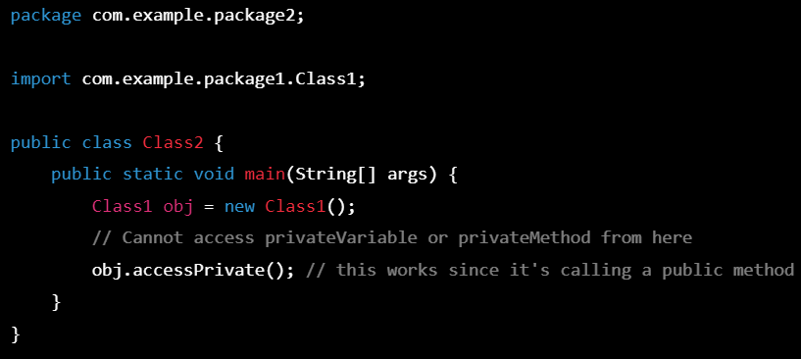
An Access Example: private specifier

Slide 31
An Access Example: private specifier
In the above example, we have a private variable and a private method inside "Class1". We cannot access them directly from "Class2". However, we have a public method "accessPrivate()" that uses these private members. We can call this method from "Class2" to indirectly access the private members.

Slide 32
An Access Example: protected specifier
Protected access modifier: Protected members can be accessed from within their own class, their subclasses, and classes in the same package. Here's an example:

Slide 33
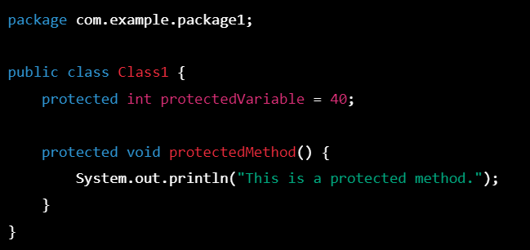
An Access Example: Protected specifier

Slide 34
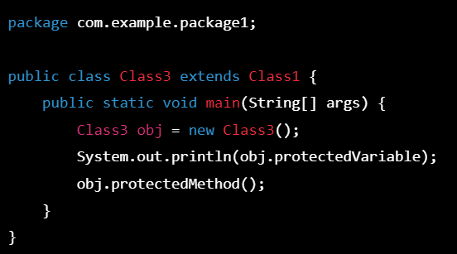
An Access Example: protected specifier

Slide 35
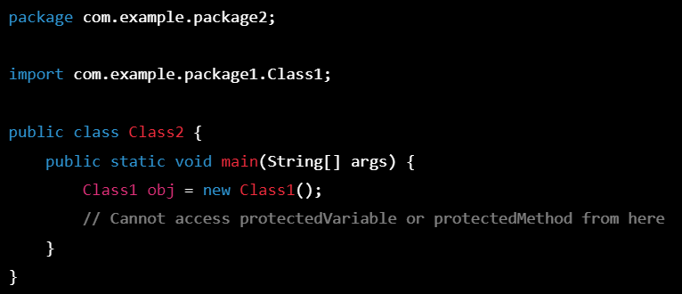
An Access Example: protected specifier

Slide 36
An Access Example: protected specifier
In the above example, we have a protected variable and a protected method inside "Class1". We can access them from a subclass of "Class1", which is "Class3". In "Class3", we have created an object of the class and accessed the protected members. However, we cannot access them from "Class2" as it belongs to a different package.

Slide 37
An Access Example: protected specifier
In the above example, we have a protected variable and a protected method inside "Class1". We can access them from a subclass of "Class1", which is "Class3". In "Class3", we have created an object of the class and accessed the protected members. However, we cannot access them from "Class2" as it belongs to a different package.

Slide 38
Interfaces
Using the keyword interface, you can fully abstract a class interface from its implementation.
Using interface, you can specify what a class must do, but not how it does it.
Interfaces are syntactically like the classes, but they lack instance variables, and, as a rule, their methods are declared without any body.
Once interface is defined, any number of classes can implement an interface.
Also, one class can implement any number of interfaces.
To implement an interface, a class must provide the complete set of methods required by the interface. However, each class is free to determine the details of its own implementation.
Interfaces are designed to support dynamic method resolution at run time.

Slide 39
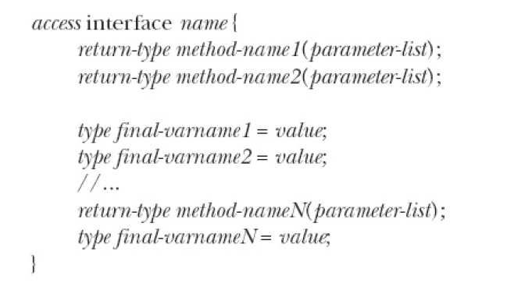
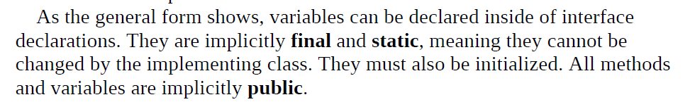
Interfaces

Slide 40
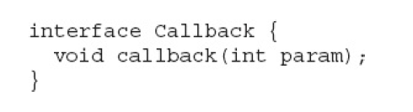
Interfaces

Slide 41

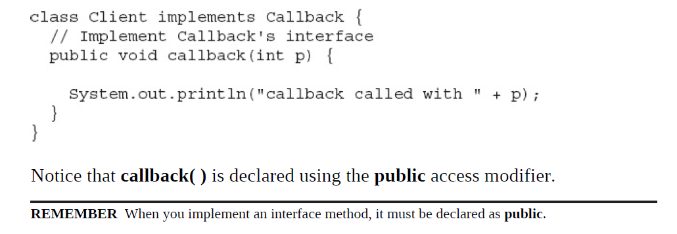
Interfaces

Slide 42
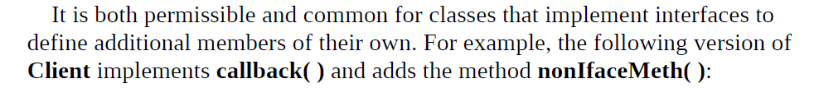
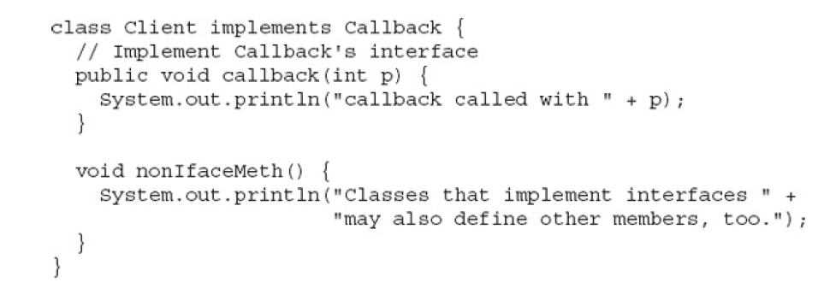
Interfaces

Slide 43
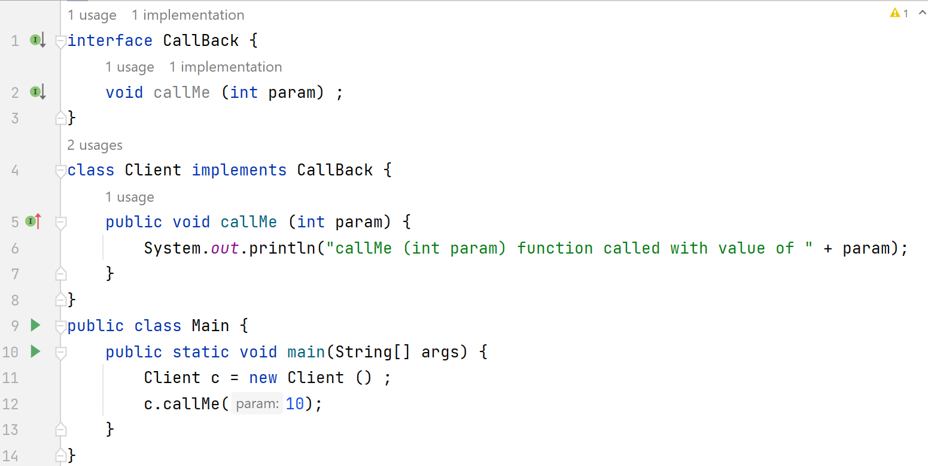
Interfaces: Example

Slide 44
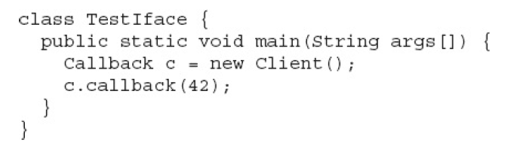


Accessing Implementations Through Interface
References

Slide 45
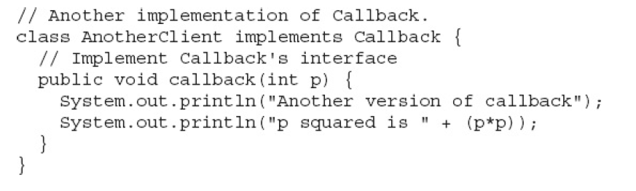
Accessing Implementations Through Interface
References

Slide 46
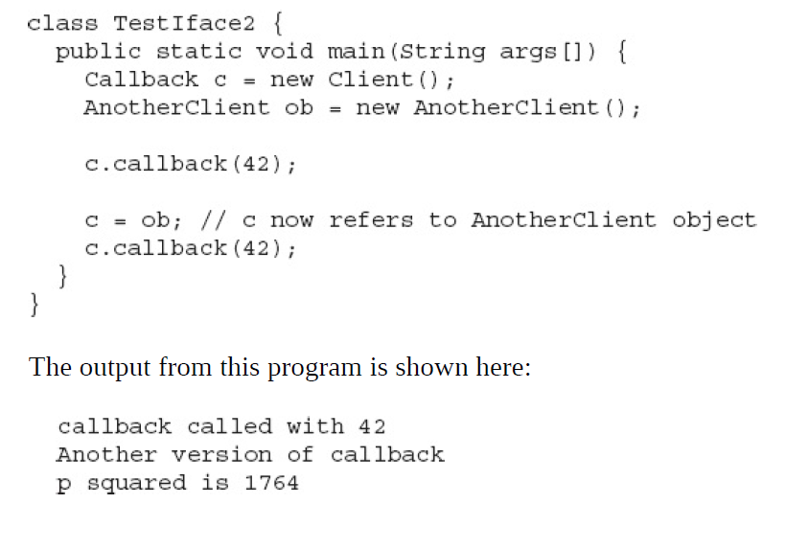
Accessing Implementations Through Interface
References

Slide 47
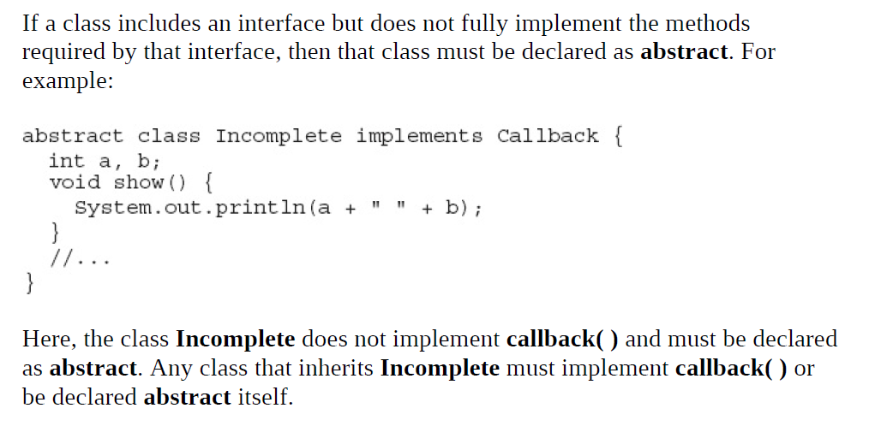
Partial Implementation

Slide 48
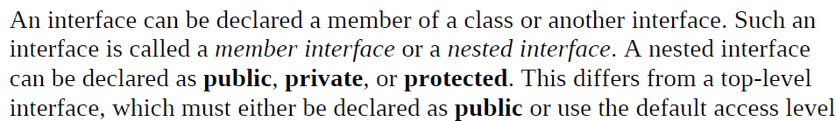
Nested Interface

Slide 49
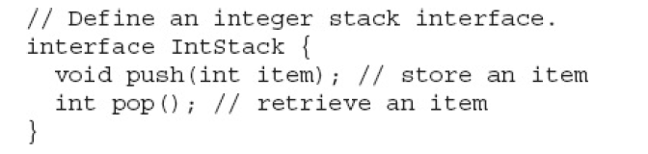
Applying Interfaces

Slide 50
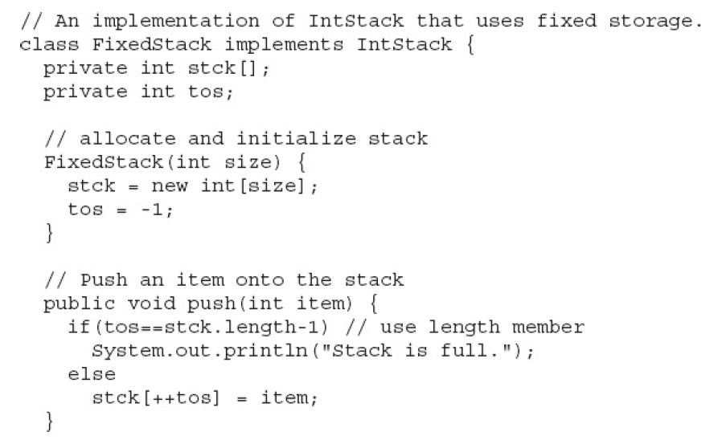
Applying Interfaces

Slide 51
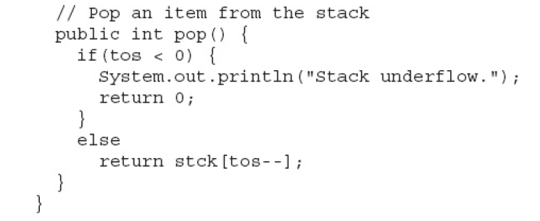
Applying Interfaces

Slide 52
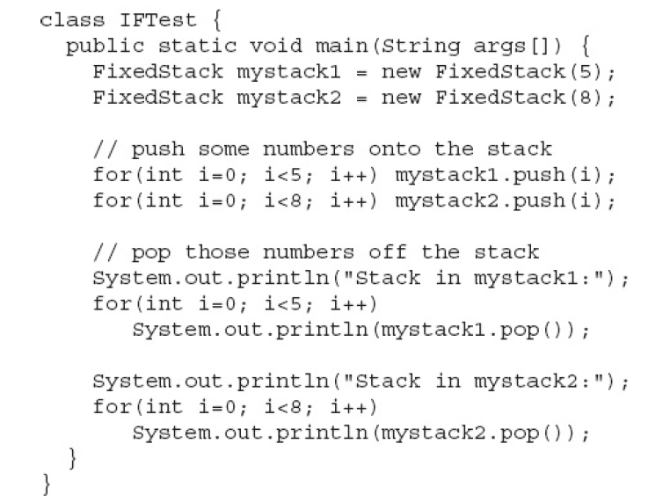
Applying Interfaces

Slide 53
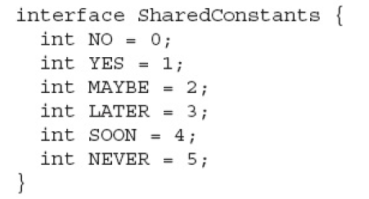
Variables in Interface
In Interface, the variables are final and static by default. These are called shared constant variables.

Slide 54
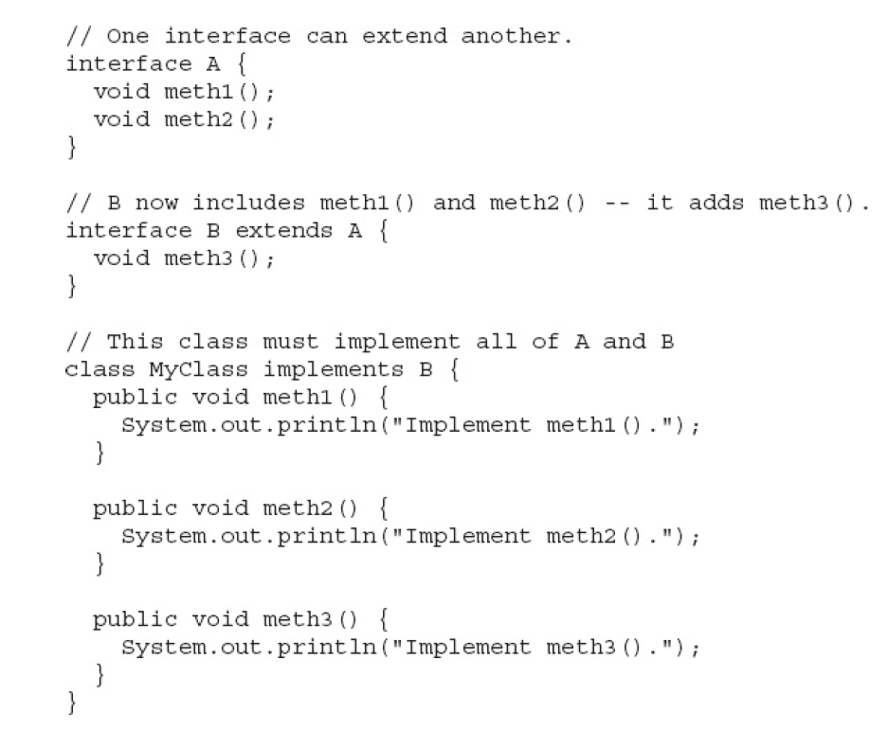
Interfaces can be extended

Slide 55
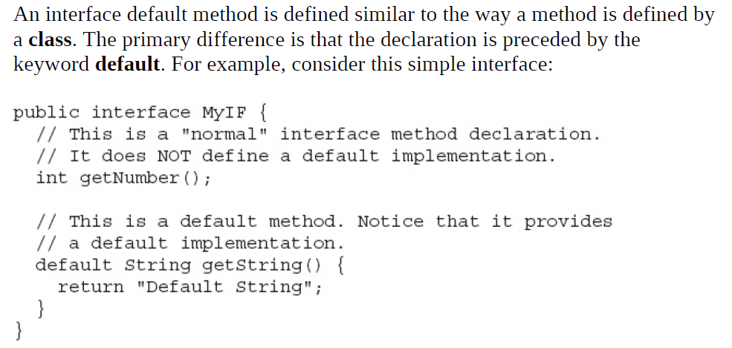
Default Method Fundamentals

Slide 56
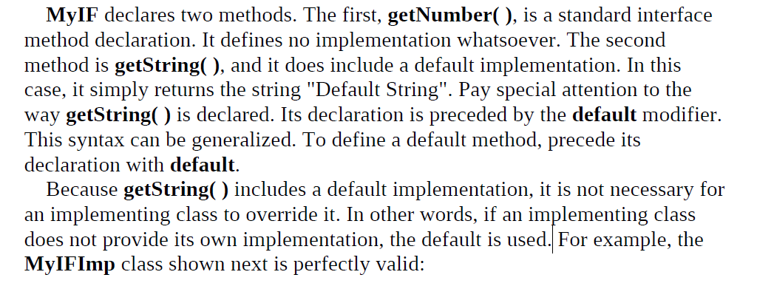
Default Method Fundamentals

Slide 57
Default Method Fundamentals

Slide 58
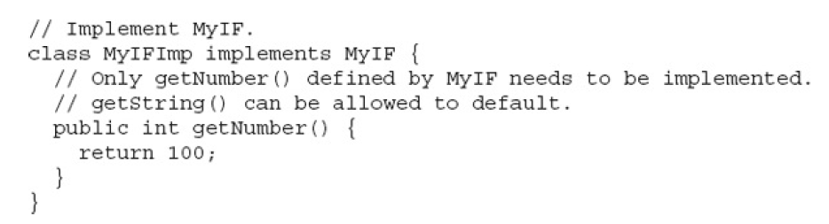
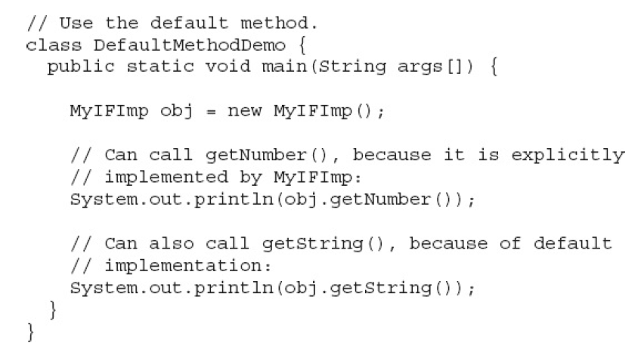
Default Method Fundamentals

Slide 59
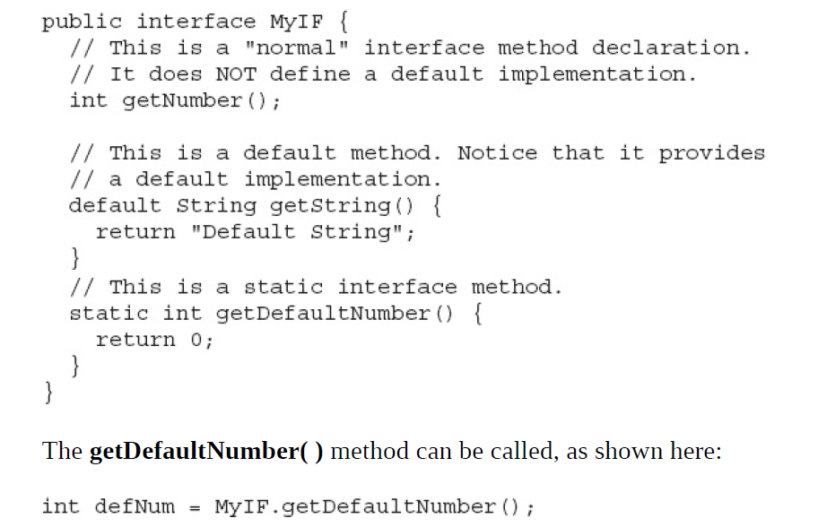
Use static Methods in an Interface

Slide 60
Recap
Packages
Interfaces

